Slide 1
Quantitative Research Design

Slide 2
Quantitative Research Design
Quantitative research seeks to determine a relationship between two or more variables.
Quantitative research is primarily related to numerical data, measurement and statistical analysis. Variables may be categorical (e.g. gender and nationality) or continuous (e.g. numerical scores relating to language proficiency, test scores and motivational levels).
The procedures of data collection and analysis are usually planned beforehand.
Determinism suggests that examining the relationships between and among variables is central to answering questions and hypotheses through surveys and experiments.

Slide 3
Quantitative Research Design
Quantitative researchers exert some form of control over their research (e.g. by using standardized instruments and by controlling data collection procedures).
Data analysis to answer research questions is mainly statistical.
Examples of quantitative research strategies include experimental research, correlational research and individual diﬀerences research
Quantitative research values breadth, statistical descriptions, and generalizability.

Slide 4
Quantitative Research Design
Quantitative approaches to research center on achieving objectivity, control, and precise measurement.
Methodologically, these approaches rely on deductive designs aimed at refuting or building evidence in favor of specific theories and hypotheses.
Marianne Fallon refers to quantitative research as a “top down process” (2016, p. 3).
Quantitative approaches are most commonly used in explanatory research investigating causal relationships, associations, and correlations.

Slide 5
Realism, subjectivism and the ‘paradigm wars’
Historically, quantitative research was guided by the philosophy of positivism, which originally developed in the natural sciences.
This tradition presupposes that reality exists independently of the research process and can be measured via the objective application of the scientific method.
Laws that govern the social world can therefore be tested and proven.
Today, postpositivism, a refined version of these principles, guides quantitative research
Realists take the view that what research does is uncover an existing reality.

Slide 6
Realism, subjectivism and the ‘paradigm wars’
This means that the researcher needs to be as detached from the research as possible, and use methods that maximise objectivity and minimise the involvement of the researcher in the research.
This is best done by methods taken largely from the natural sciences.
According to positivism, the world works according to fixed laws of cause and effect.
Scientific thinking is used to test theories about these laws, and either reject or provisionally accept them.

Slide 7
Realism, subjectivism and the ‘paradigm wars’
This view that there is a true reality out there that we can measure completely objectively is problematic.
We are all part of the world we are observing, and cannot completely detach ourselves from what we are researching.
Historical research has shown that what is studied, and what findings are produced, are influenced by the beliefs of the people doing the research and the political/social climate at the time the research is done.
According to this viewpoint, qualitative researchers are subjectivists.
All truth can only be relative, and is never definitive.
There is no pre-existing objective reality that can be observed. The process of our observing reality changes and transforms it, and therefore subjectivists are relativistic.

Slide 8
Post-positivism, experiential realism and pragmatism
Post-positivists accept that we cannot observe the world we are part of as totally objective and disinterested outsiders, and accept that the natural sciences do not provide the model for all social research.
While we will never be able to totally uncover that reality through our research, post-positivists believe that we should try to approximate that reality as best we can.
Rather than finding the truth, post-positivists will try to represent reality as best they can.

Slide 9
Post-positivism, experiential realism and pragmatism
In contrast to positivists, post-positivists believe that research can never be
certain.
A second world view or epistemology that underlies the work of some quantitative researchers is called experiential realism.
Experiential realism claims that we cannot observe the world in a purely objective way, as our perception itself influences what we see and measure.
In contrast to subjectivist positions, however, experiential realists believe that there is a limit to subjectivity.
This is because our perception is ‘embodied’. We don’t observe passively, but actively interact with the world through our bodies.

Slide 10
Pragmatism
One of the main contentions of pragmatism is that the meaning and the truth of any idea are a function of its practical outcome(s).
Pragmatists strongly oppose the absolutism they see as a key part of most other philosophical beliefs.
They feel that too often a chosen philosophy is put in opposition to other philosophies (think of the positivist/subjectivist debate), which are totally rejected.

Slide 11
When do we use quantitative methods?
There are four main types of research questions that quantitative research is particularly suited to finding an answer to:
1. The first type of research question is that demanding a quantitative answer. Examples are: ‘How many students choose to study education?’ or ‘How many maths teachers do we need and how many have we got in our school district?’ That we need to use quantitative research to answer this kind of question is obvious. Qualitative, non-numerical methods will obviously not provide us with the (numerical) answer we want.
2. Numerical change can likewise accurately be studied only by using quantitative methods. Are the numbers of students in our university rising or falling? Is achievement going up or down? We’ll need to do a quantitative study to find out.

Slide 12
When do we use quantitative methods?
3. As well as wanting to find out about the state of something or other, we often want to explain phenomena. What factors predict the recruitment of English teachers? What factors are related to changes in student achievement over time? As we will see later on in this book, this kind of question can also be studied successfully by quantitative methods, and many statistical techniques have been developed that allow us to predict scores on one factor, or variable (e.g. teacher recruitment) from scores on one or more other factors, or variables (e.g. unemployment rates, pay, conditions).
4. The final activity for which quantitative research is especially suited is the testing of hypotheses. We might want to explain something – for example, whether there is a relationship between pupil’s achievement and their self-esteem and social background. We could look at the theory and come up with the hypothesis that lower social class background leads to low self-esteem, which would in turn be related to low achievement. Using quantitative research, we can try to test this kind of model

Slide 13
What is a hypothesis?
A hypothesis is a tentative explanation that accounts for a set of facts and can be tested by further investigation.
For example, one hypothesis we might want to test is that:
«Poverty causes low achievement.»
«There is a relationship between pupils’ self-esteem and the amount of time they spend watching television.
Quantitative researchers design studies that allow us to test these hypotheses.
We collect the data (for example, parental income and school achievement) and use statistical techniques to decide whether or not to reject or provisionally accept the hypothesis.
Accepting a hypothesis is always provisional, as new data may emerge that
reject it later on

Slide 14
Questions that are not well suited to quantitative methods
Quantitative research is good at providing information in breadth, from a large number of units, but when we want to explore a problem or concept in depth, quantitative methods can be too shallow. To really get under the skin of a phenomenon, we will need to go for ethnographic methods, interviews, in-depth case studies and other qualitative techniques.
We saw above that quantitative research is well suited for the testing of theories and hypotheses. What quantitative methods cannot do very well is develop hypotheses and theories. The hypotheses to be tested may come from a review of the literature or theory, but can also be developed by using exploratory qualitative research

Slide 15
Questions that are not well suited to quantitative methods
3. There is a limit to how many variables can be looked at in any one quantitative study, and partly because in quantitative research the researcher defines the variables to be studied herself, while in qualitative research unexpected variables may emerge.
4. Finally, while quantitative methods are best for looking at cause and
effect (causality, as it is known), qualitative methods are more suited to
looking at the meaning of particular events or circumstances.

Slide 16
mixed-methods
Mixed-methods research is flexible, where the research design is determined by what we want to find out rather than by any predetermined epistemological position.
In mixed-methods research, qualitative or quantitative components can predominate, or both can have equal status

Slide 17
Experimental Research
Experimental research is the oldest form of quantitative research. After the scientific revolution in the 17th century, experiments in research came to mean “taking a deliberate action followed by systematic observation” (Shadish, Cook, & Campbell, 2002, p. 2).
Experiments rely on hypothesis testing (testing variable relationships).
The basic use of experiments is to test how introducing an intervention (a variable) affects what happens.
In other words, you select research subjects, do something to them, and observe the effect of what you’ve done (Babbie, 2013).

Slide 18
Experimental Research
Experiments are used in explanatory research and are based on causal logic (or cause-and-effect logic).
This logic looks at identifying causal relationships between variables (e.g., A causes B or A causes B under C circumstance).
The cause must precede the effect (temporal order), the cause must be related to the effect, and there must be no alternative explanation for the effect (Shadish et al., 2002).
Explained in terms of variables: The independent variable precedes the dependent variable. The independent variable must be related to the dependent variable.

Slide 19
Experimental groups are those that receive the experimental intervention.
Control groups do not receive the intervention.
All experiments have at least one experimental group, but not all experiments have control groups.
Control groups are used to compare the results of the experimental group.
Some experiments involve pretests and/or posttests in addition to the experimental intervention.

Slide 20
Surveys
Survey research is the most widely used quantitative design in the social sciences.
Common uses of survey research include the census, polling on political issues or public opinions, and market research.
Surveys rely on asking people standardized questions that can be analyzed statistically.
They allow researchers to collect a breadth of data from large samples and generalize to the larger population from which the sample was drawn.
Surveys are typically used for ascertaining individuals’ attitudes, beliefs, opinions, or their reporting of their experiences and/or behaviors.

Slide 21
There are two primary methodological designs in survey research: cross-sectional and longitudinal (Ruel, Wagner, & Gilllespie, 2016).
Cross-sectional designs seek information from a sample at one point in time.
Longitudinal designs occur at multiple times in order to measure change over time.
Questionnaires are the primary data collection tool in survey research.
There must be clear and justifiable links between your indicators (questions) and the concepts you say you are measuring.

Slide 22
SURVEYS
A survey design provides a quantitative or numeric description of trends, attitudes, or opinions of a population by studying a sample of that population.
From sample results, the researcher generalizes or makes claims about the population.

Slide 23
Population, Sampling, and Subjects
Simple random sampling (SRS; also called random selection) allows every element in the study population an equal chance of being selected.
Systematic sampling is a strategy in which the first element in the study population is selected randomly and then every kth element, after the first element, is selected.
Cluster sampling is a multistage strategy. First, preexisting clusters are randomly selected from a population. Next, elements in each cluster are sampled (in some cases, all elements in each cluster are included in the sample
Convenience sampling involves identifying research subjects based on their accessibility to the researcher.

Slide 24
Data Analysis and Assessment
Descriptive statistics describe and summarize the data (Babbie, 2013; Fallon, 2016). There are three kinds of descriptive statistics (Fallon, 2016, pp. 16–18):
1. Frequencies: Count the number of occurrences of a category. Frequencies are generally reported as percentages. For example, in a sample of 100 female respondents, you count the number who reported being on a diet. Sixty-seven out of 100 reported being on a diet. You report this as 67% of female respondents reported being on a diet.
2. Measures of central tendency: Use a single value to represent the sample.
a. Mean: the average
b. Median: the “middle” value
c. Mode: the most frequent value in the sample

Slide 25
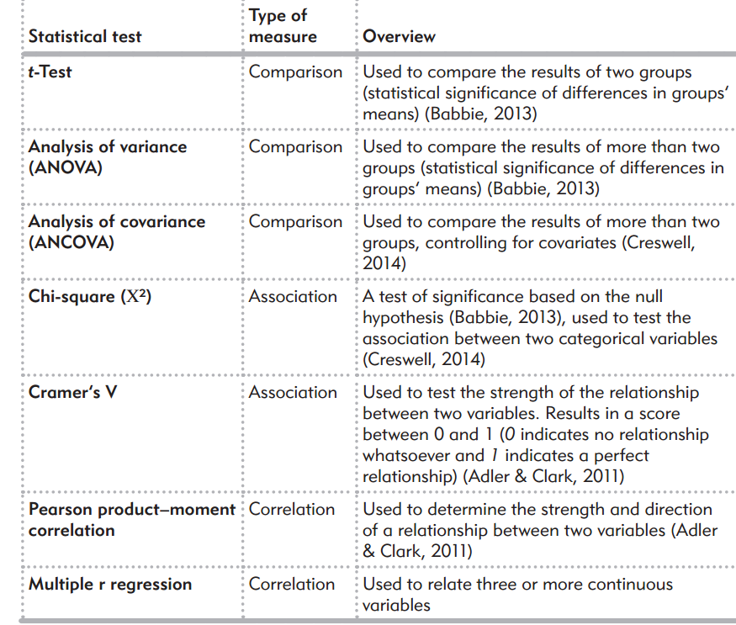

Slide 26
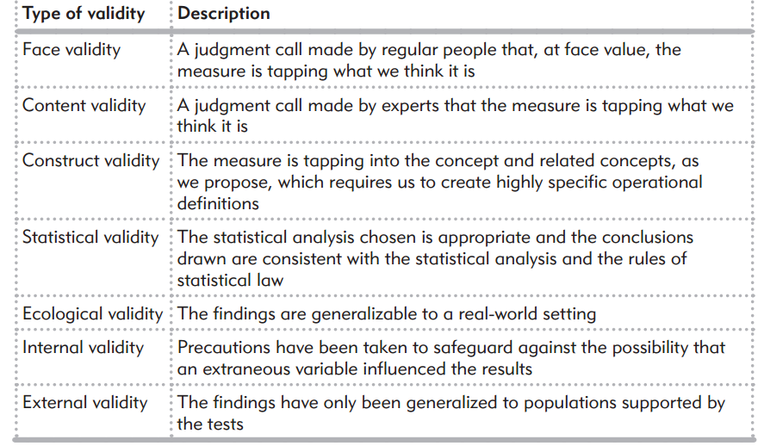
Validity

Slide 27
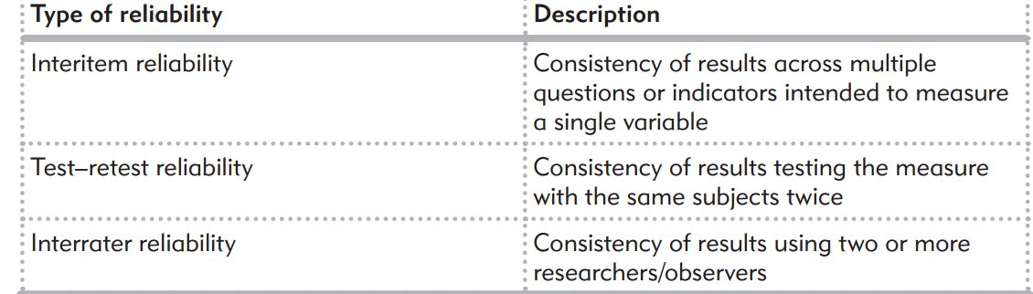
Reliability
If a measure, a survey instrument, or an experimental intervention is reliable, it will yield consistent results.

